Slide 1
Navigating Life Relationships
Teacher: Sam

Slide 2
If you learn to understand how people communicate, you will learn more, be more convincing, and present yourself flatteringly.

Slide 3

How do we communicate with each other?
Verbal
Words
Context for your words
Tone
Actions
Things you do
Things you don’t do
Body Language
Posture
Body movements
Facial movements

Slide 4
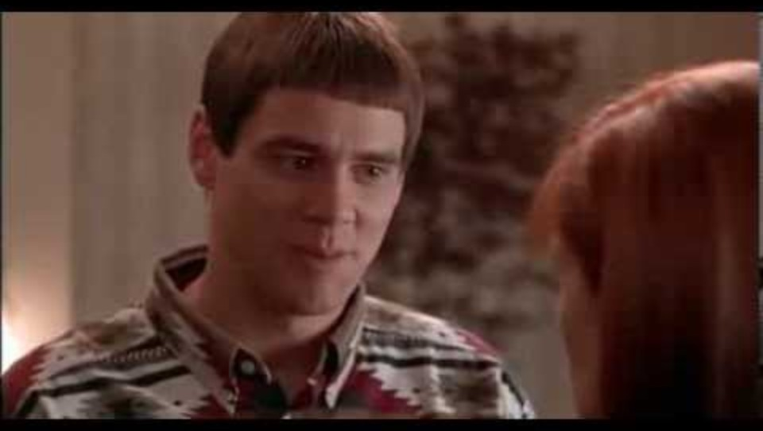
Talk

Slide 5

Talk - Words
Our words are how we communicate ideas and thoughts. It’s what we think of when we say “communication.”
The right words in the right situation can be extremely powerful.
The wrong words at the wrong time can be just as devastating!
We’re all vulnerable to it!

Slide 6
Talk – Context for words
The situation you are in can be very important for what speech you use!
What is appropriate in one setting might not be in another.
When could it be inappropriate to say:
“Whatever, dude. I don’t really care.”
Or, when would it be weird to say:
“Yes, sir. I understand, sir!”

Slide 7

Talk – Tone
How you say something is almost as important as what you say.
What does this mean:
“What are you doing here?”

Slide 8
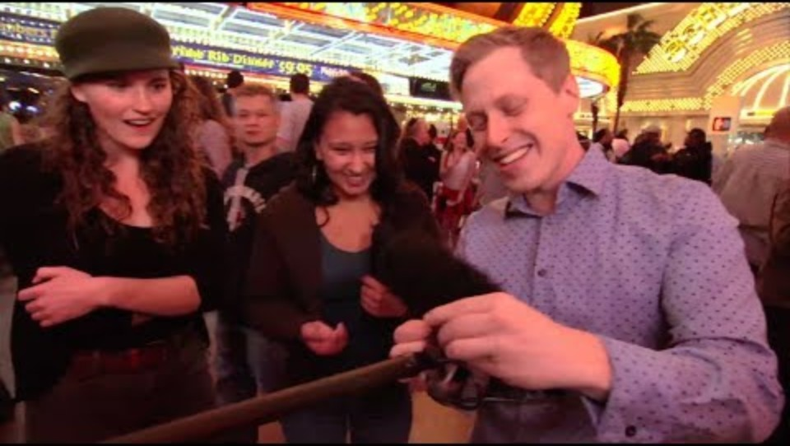
Actions

Slide 9
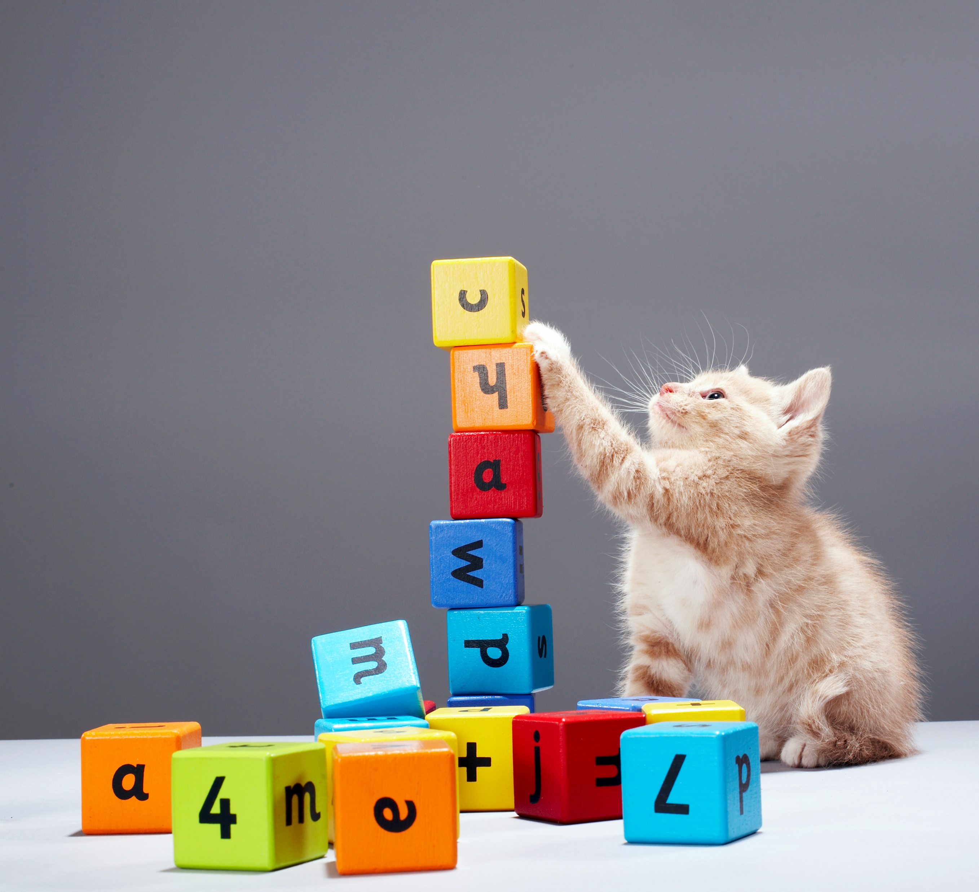
Actions – Things You Do That Effect Relationships
  Positive:
    Follow up on something quickly
    Remember things they have said in the past
    Do something for them
    Hold your phone for you while you try to do a viral dance so you can finally get famous and meet Bunny the sheepadoodle dog from that one TikTok of the dog pressing the buttons.
  Negative:
    Do or say something you told them you wouldn’t do or say
    Hit them with your car

Slide 10

Actions – Things You DON’T Do That ALSO Effect Relationships
  Positive:
    Letting someone go in front of you
    Letting someone else speak
    Not bringing up the spaghetti video
  Negative:
    Not responding to a question
    Not answering honestly or “in good faith”
      What does that mean?
      People can tell!

Slide 11
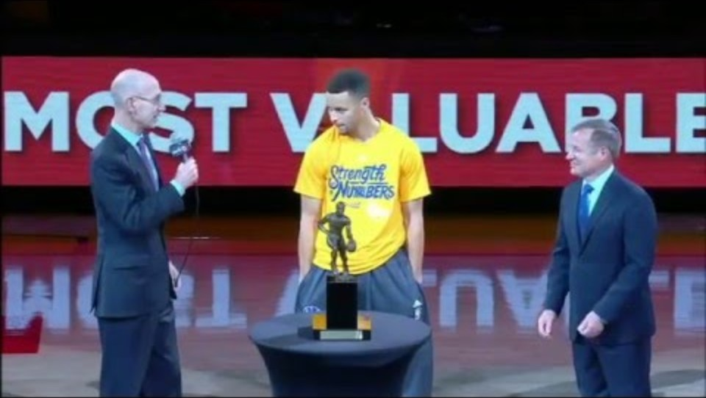
Body Language

Slide 12
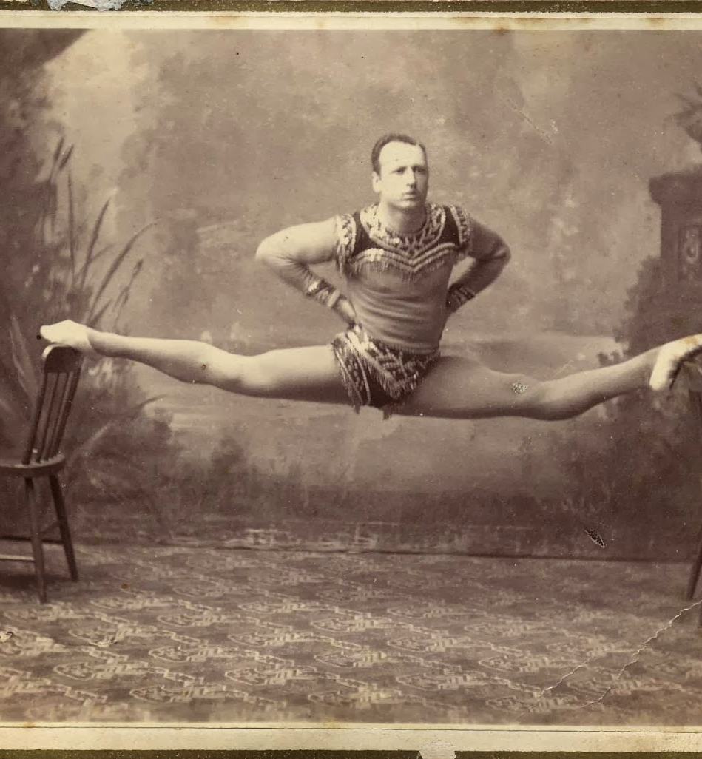
Body Language
How much of communication do you think is body language?
Studies have shown that most of communication is body language!
How you present yourself
Your posture
Your facial movements
Your hand movements
The way you are facing
All of these factors are easier for our brains to interpret than what comes out of your mouth!

Slide 13





Body Language Game
Tell me what you’re thinking without “telling” me!

Slide 14
Relationships
Friend
Coworker
Partner
Boss
Peer
Subordinate

Slide 15
Where do you put each relationship?
(Friend, Coworker, Partner, Boss, Peer, Subordinate)
Friend
Coworker
Boss
Partner
Peer
Subordinate
Casual
Professional

Slide 16
What Does Respect Mean?
Respect will mean different things to different people!
What does respect mean to your boss?
A judge?
Peers?
Partner?
People tend to reflect behavior. (UO Study)
  When people meet each other, they tend to see the other person as a reflection of how they feel.
  If you want something from someone, it is almost always the best plan to be pleasant to them so they are equally pleasant to you!

Slide 17
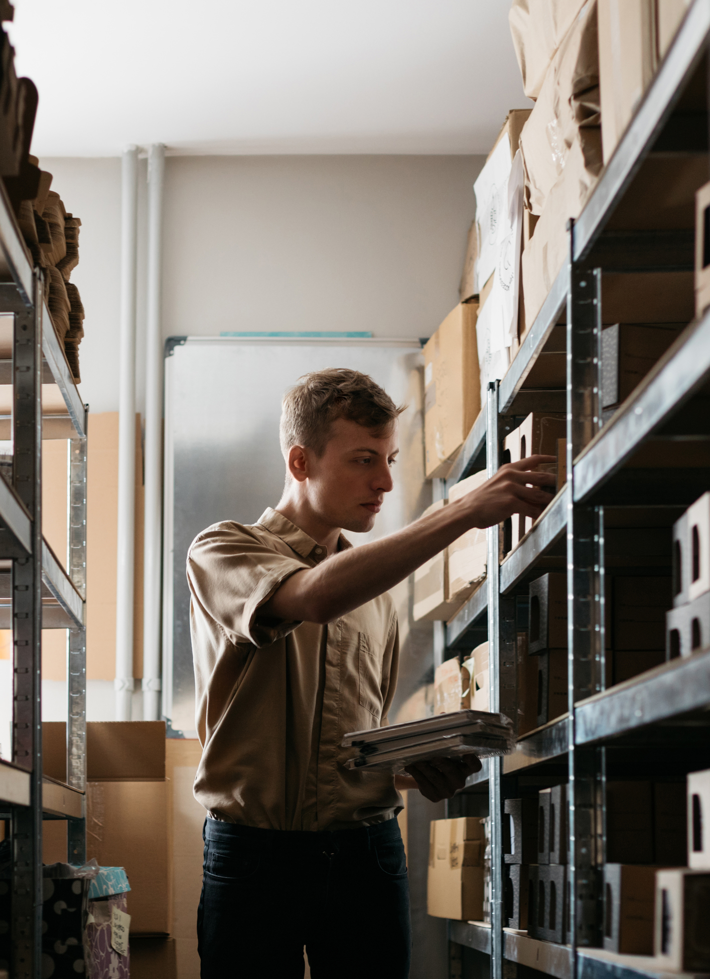
Workplace – Boss, Coworker, Subordinate
Respectful
Professional
Clear
Timely
Some workplaces are more casual than others and that can be great! Just be sure that you know the rules and the customs of that office and always stay respectful and appropriate!

Slide 18
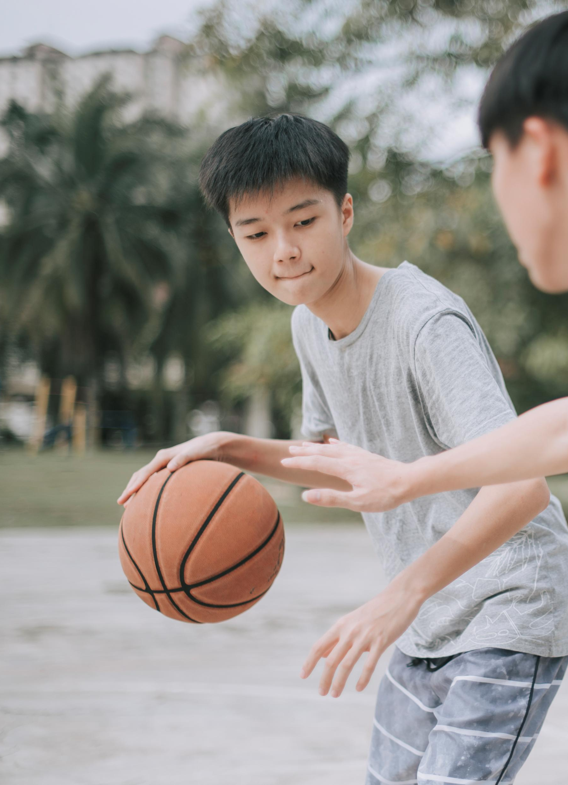
Friends and Peers
Casual and relaxed
Still respectful and appropriate
Being aware of what people say and how they act
Friends and peers are usually more relaxed and there are fewer rules about communication.
Respect is still important! But especially with friends, knowing what they are comfortable with, you can be a lot more casual!

Slide 19

Partners
All about respect and open communication!
Your partner needs to be respectful of you as well!
A partner relationship where both people know each other, respect each other, and communicate well is the best possible example of a relationship!

Slide 20
Case Study 1 – Tired Boss
Your boss calls you into her office. She tells you to sit down. She seems tired and maybe a little annoyed. Before she starts speaking, she takes a deep breath.
She tells you that she has been watching your hard work, and you are up for a promotion!
You are very excited by this and glad to hear that she has noticed your hard work.
She asks pointedly, “Well, what do you think?”
What is your response?
What communication factors are at play?

Slide 21
Case Study 2 – Roommate Troubles
You have been friends with Parker for years! Parker asked to stay at your place for a few days. However, a “few days” has turned into a few weeks! You have been understanding of Parker’s position and let them stay at your apartment longer than they predicted.
However, Parker does not seem to understand the stress of having a guest for weeks! Whenever you ask them what their plan is for moving out, they deflect the question with a joking, “what, you don’t like me anymore?”
How do you respond kindly while also having your needs acknowledged?
What relationship dynamics are at play?

Slide 22
Thank you!
Join us next class to learn about health, doctors, and insurance!
Make sure to leave a review!

