Slide 1
Buying Your First Car
Teachers: Sam and Mr. Pugh

Slide 2

Question:
What do you want out of your first car?

Slide 3
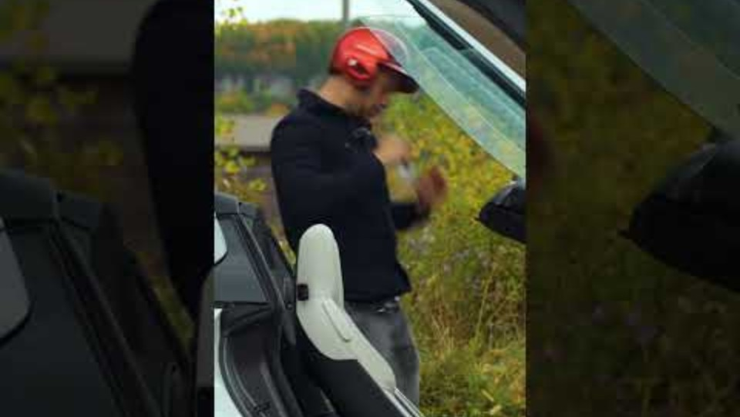
Reasons to research your vehicle

Slide 4
New Car:
Pros and Cons
PROS:
Usually more comprehensive warranty
Unlikely to have issues immediately
No previous owners so no risk of hidden damage
It probably smells like a pine tree or something
More lifetime of the car
CONS:
Much more expensive
Loses value very quickly
It will be a “used car” as soon as you buy it
No one can tell the difference between a well-maintained used car and a “new” car after 3-6 months.
Repair, upkeep, and parts are more expensive

Slide 5
Used Car:
Pros and Cons
PROS:
Much less expensive
No need to worry about the inevitable minor dings and scratches
Not eating the 20% “off the lot” value loss
Significantly lower insurance cost
Used parts are much cheaper if you want to mod your vehicle
CONS:
Higher rate of issues (192 per 100 in new versus ~250 per 100 in used)
    New vs. Used-Car Value Statistics
Might not have a pine smell
May have minor cosmetic damage

Slide 6
Dealerships
Don’t go in blind. Know and have a screenshot of some cars on their lot
Have a budget in mind and don’t let anyone talk you over it! If you need to readjust your budget, come back on another day
Be willing to walk away form any car! Dealerships like to change the price or add fees after they think you are getting attached to the car!
They want you to fall in love with it THEN talk money, not the other way around
If you can’t see/touch/drive the car before buying, then don’t buy!

Slide 7
Third-Party
A third-party seller is anyone you purchase from that isn’t a dealer or a business. Facebook Marketplace, Craigslist, other private listings.
Before buying from a their-party, you must get the vehicle inspected by a trusted mechanic. This is a MUST. You need to know what you’re getting into!
Use the VIN (Vehicle Identification Number) to search the car’s history on CarFax
Ask the seller for a detailed vehicle history and report.
Ask about accidents, repairs, anything that the person should know.
Check the seller’s details. If it is a new account, don’t buy!
Never pay for ANYTHING with gift cards! This is a clear sign of a scam.
If you can’t see/touch/drive the car before buying, then don’t buy!

Slide 8
Online
Online only sellers like Carvana can look very legit but they have more ways to hide issues in their cars!
Be on the lookout for doctored photos and “deep” deals
Research the area the car was first sold in to see if there are known issues
Don’t ever pay a separate fee to have the car shipped to you!
Online shopping is easier because it is more expensive!
You will not be able to negotiate the price of the car.
If you can’t see/touch/drive the car before buying, then don’t buy!

Slide 9

The farther from a dealer you go, the more legwork you have to do to make sure that car is going to be reliable.

Slide 10
Vehicle History
For used cars, vehicle history is very important to know! It can tell you things that just looking at the car cannot.
Things to look for in a vehicle history:
Location the car has been sold. If was sold in a wet climate like Florida or Louisianna it might have water damage!
Regular oil changes. About one for every 7,000 miles on the odometer. Regular oil changes are the best predictor of a long-living car!
Milage. If the car has no miles for a long time or ever shows inconstancies in milage numbers, that is a big red flag!

Slide 11
The Two Golden Rules of Car Buying:
If it looks too good to be true…
it probably is!
Always be willing to walk away! There are plenty of other cars so don’t get pressured into a “deal” you don’t want

Slide 12
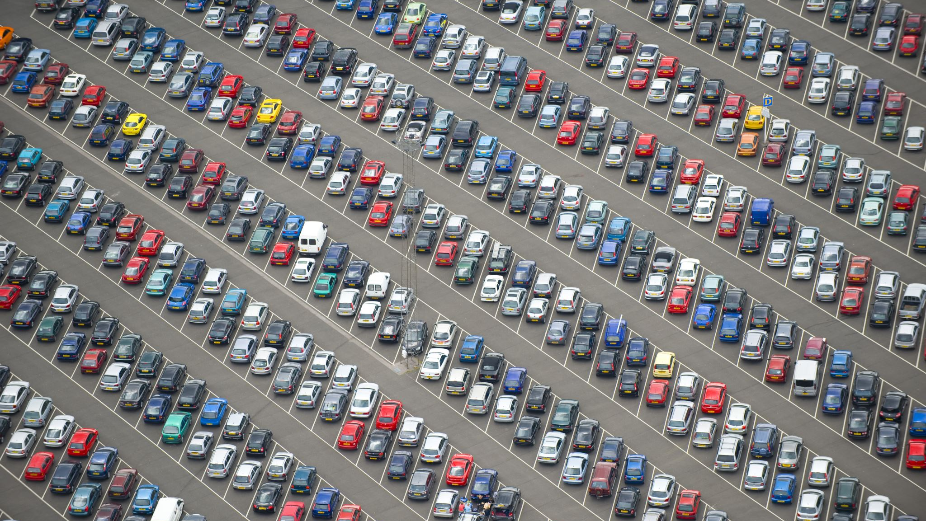
Question:
Does anyone know the average amount of money spent on cars?

Slide 13

The average ... | New cars | Used cars
Monthly payment | $737. | $520.
Loan amount | $41,068. | $26,091.
Interest rate | 6.61%. | 11.74%.
Loan term | 68.17 months. | 67.15 months.
Credit score | 755. | 694.
Source: Experian Information Solutions, 3rd quarter 2024.

Slide 14

More reasons to research the car you are looking at
Gas milage
Known and future issues
Sizing and capacity
Insurance costs

Slide 15
Know Your Listings!
Be aware of these things when looking at an online listing:
Legitimate website
  Autotrader
  CarMax
  Car Gurus
  Dealer sites
  Carvana (has had issues in the past)
High-quality, modern photos
  Look for multiple angles and pictures that look reasonable
Milage
  Milage is the biggest factor in the price of a used car. If it is significantly lower than other cars around the same price, be very careful!
Accident history
  In general, look for cars without major accidents. Even fender benders can sometimes leave damage that isn’t recorded on the listing.

Slide 16
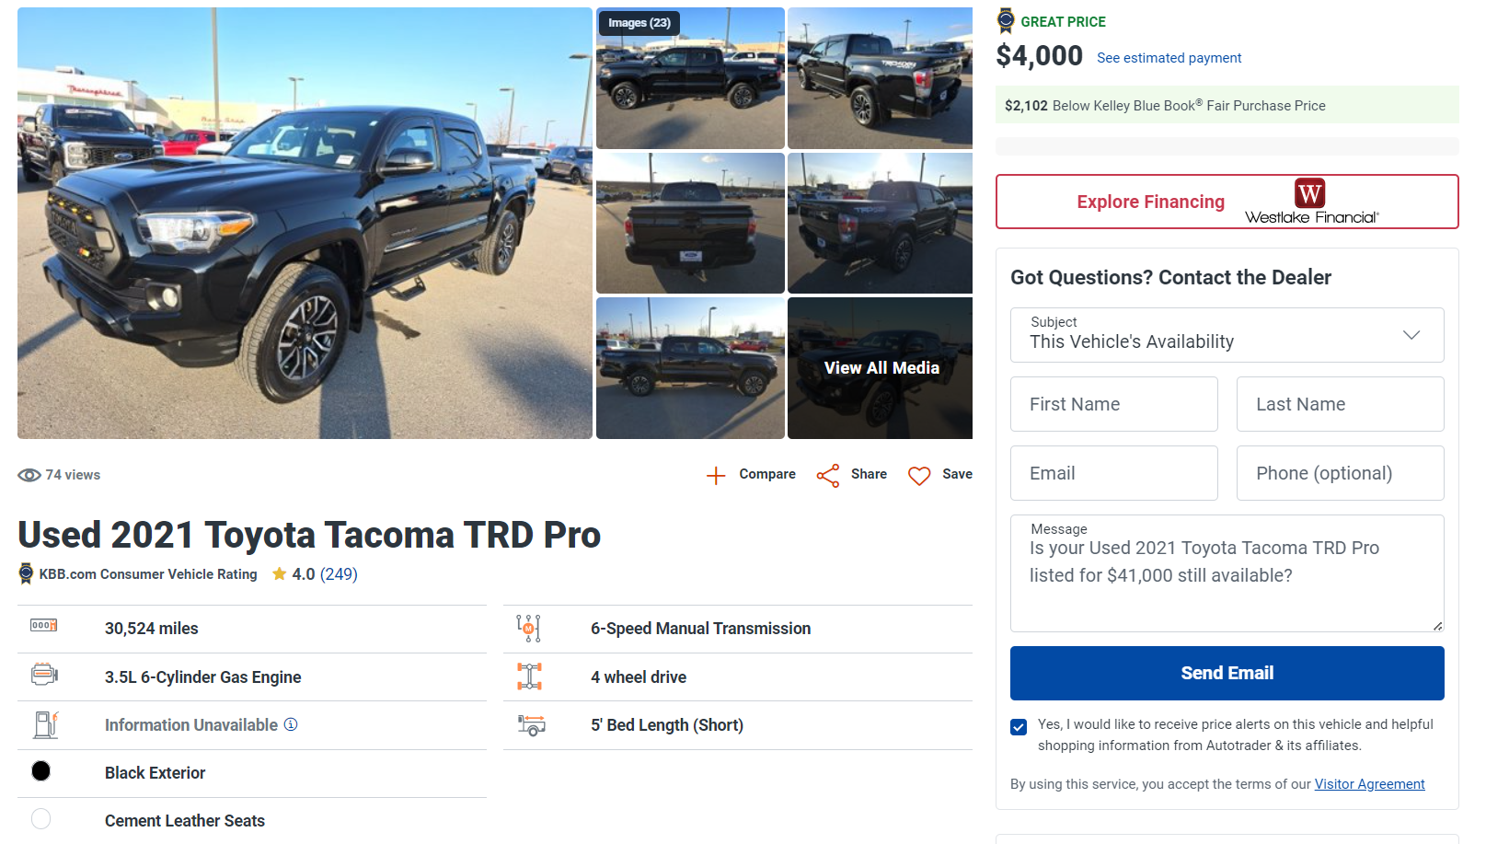

Slide 17
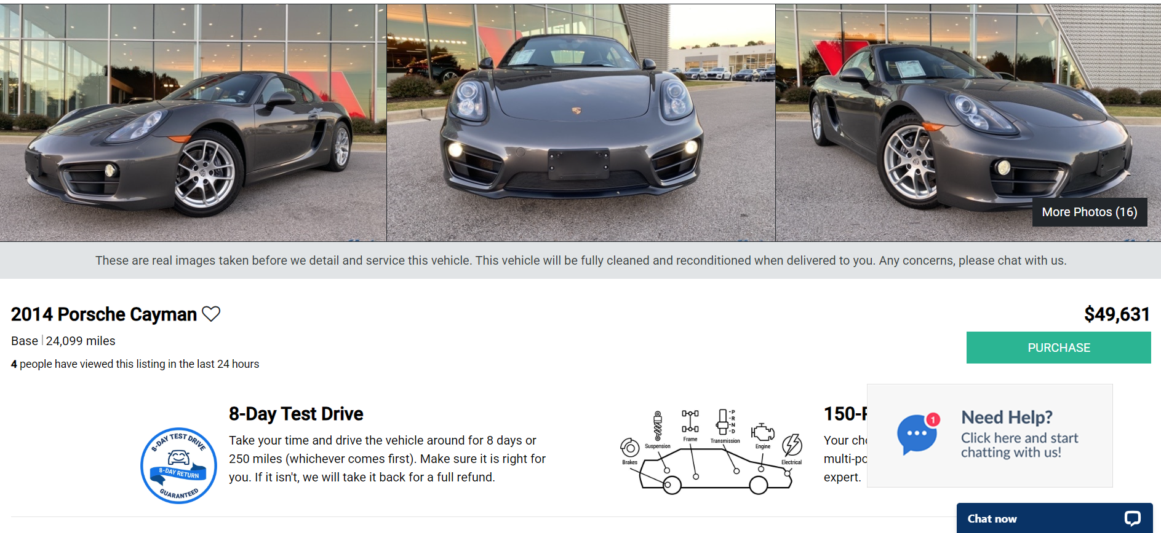
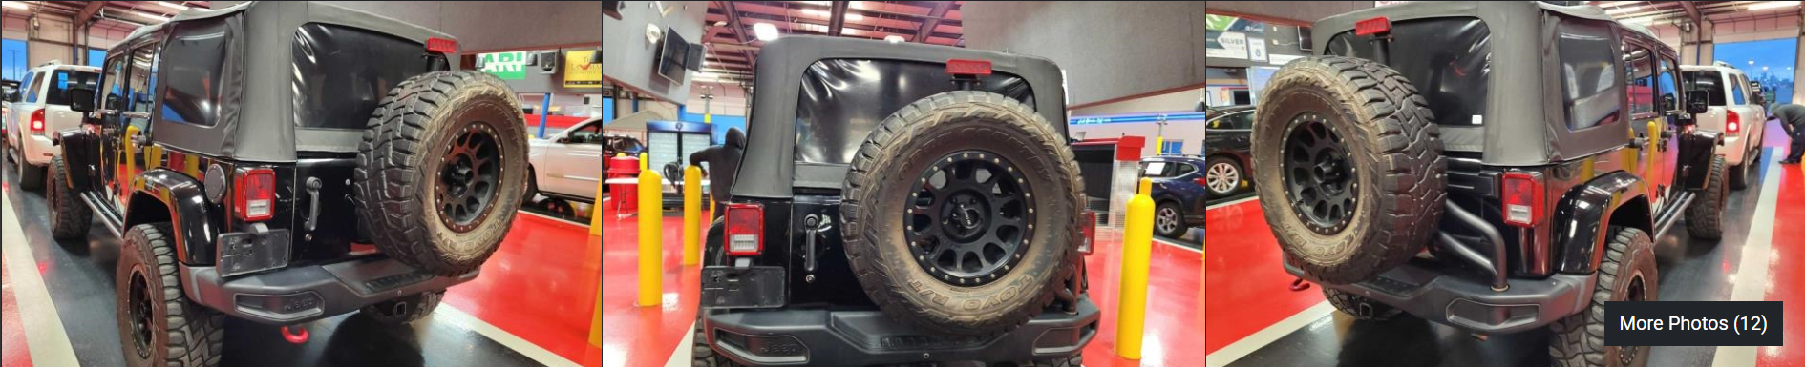

Slide 18
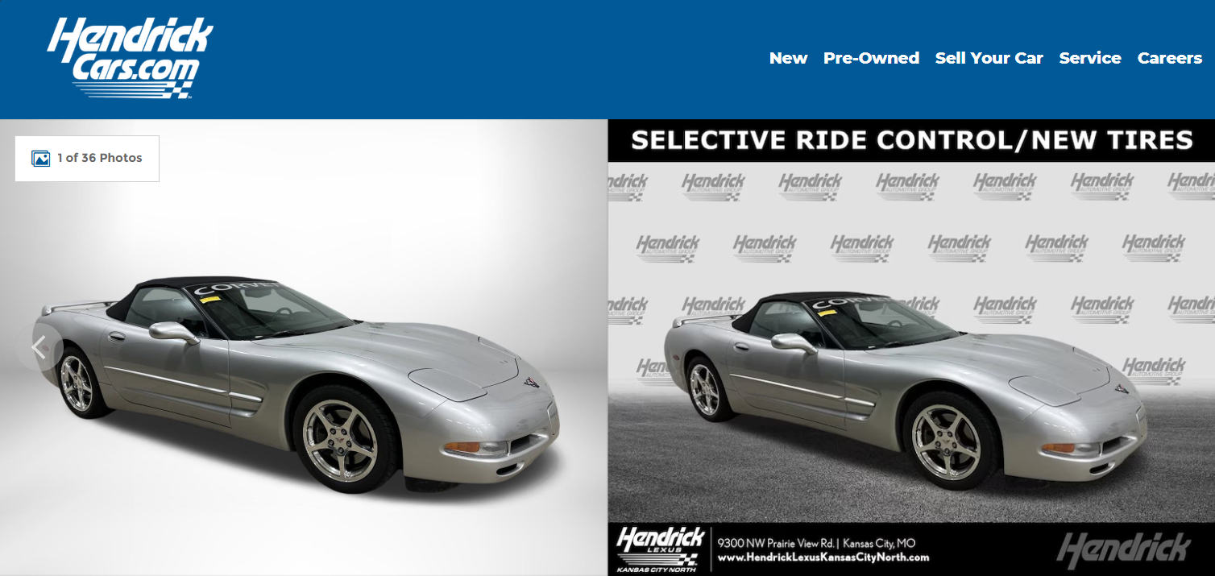
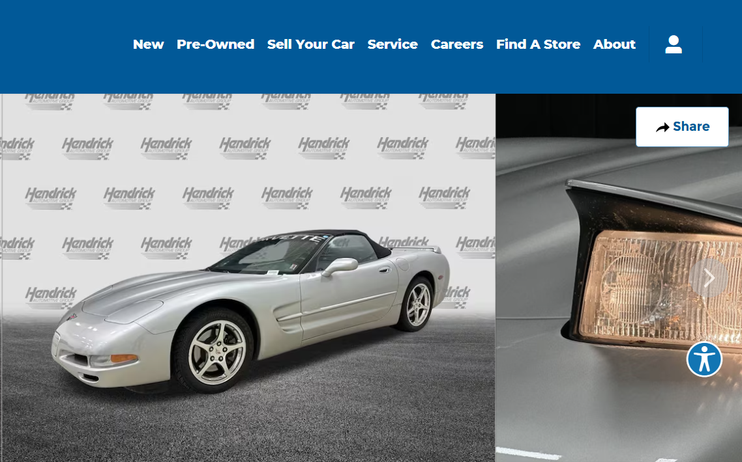
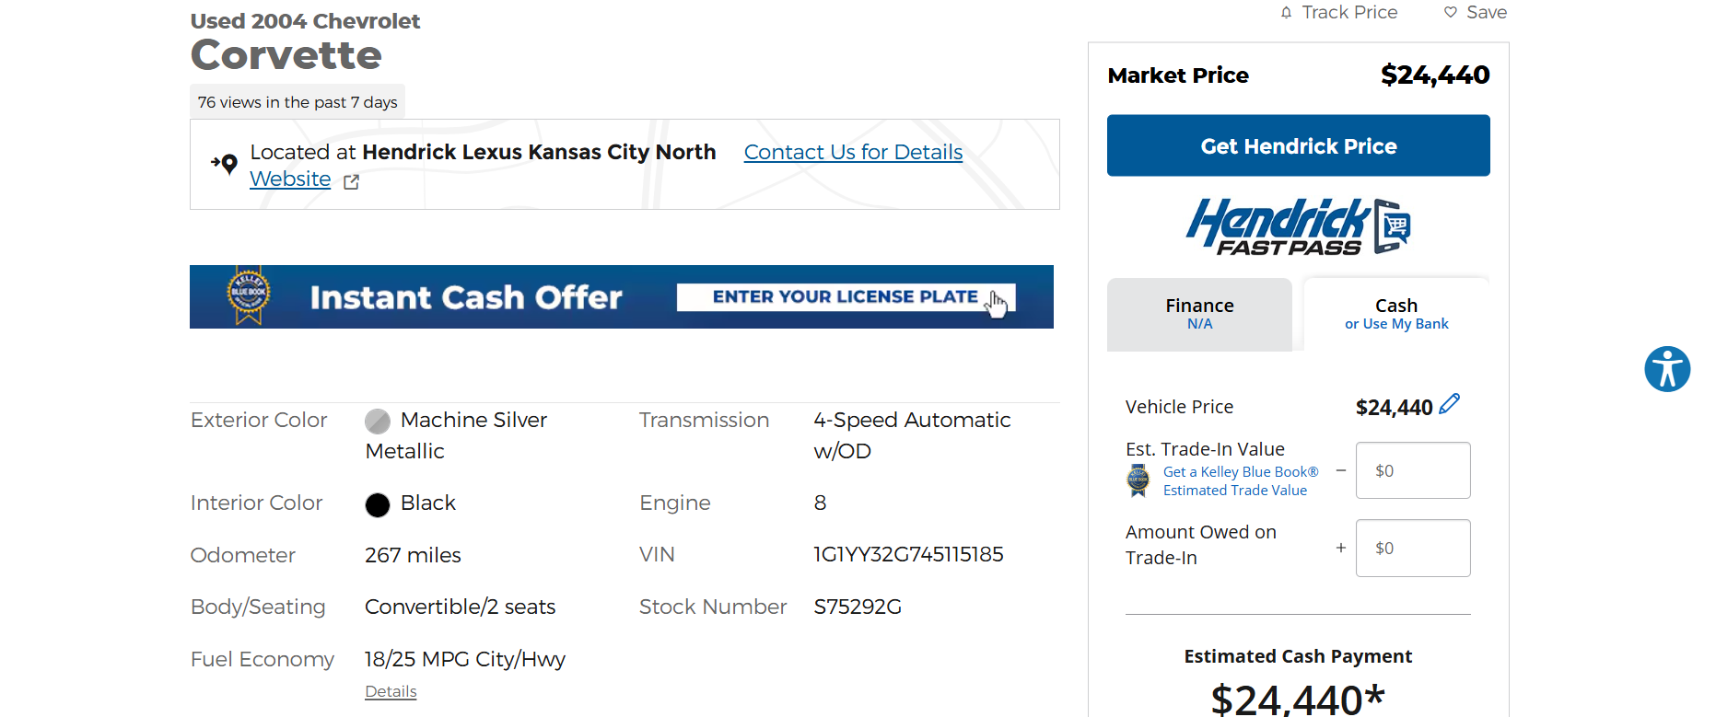

Slide 19
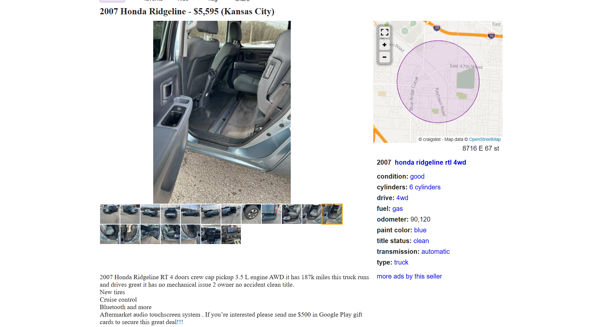

Slide 20
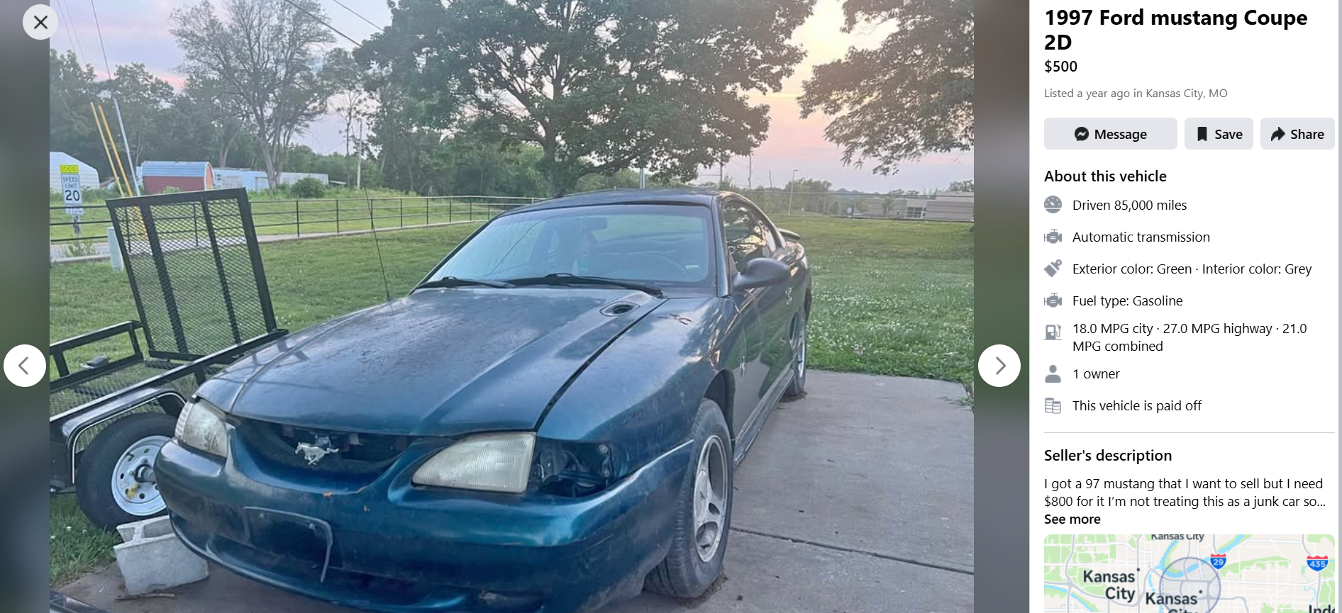
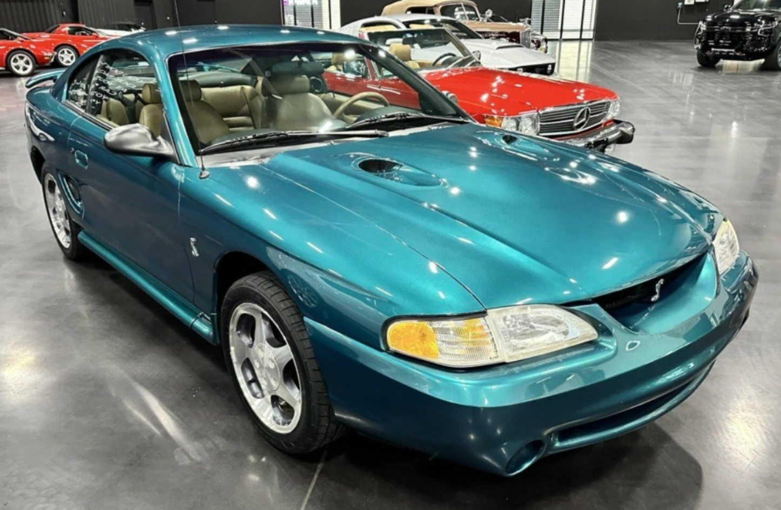

Slide 21
So….What Car Should I Buy?
That’s the beauty of it! You get to choose.
Most experts recommend starting with a cheaper used car that seems like it will last a while. This allows you time to build up some money to buy your dream car and it doesn’t cripple you with debt!
You are also protecting your dream car! You are much more likely to damage your first car than a future one. It can be a smart strategy to use your first car as a buffer!

Slide 22
Thank you!
Please give us feedback on a form!

