Slide 1

Health and the Medical System
Teacher: Sam

Slide 2
The adult in the room
We’re talking about some adult subjects today.
You’re not quite adults yet, but I am going to speak to you like you are.
Nothing in here is supposed to scare you off or freak you out—just to inform you about real life!

Slide 3
Types of Health
Physical health
Nutritional health
Mental health
Sexual health

Slide 4

Physical Health
Physical ailments
  Sicknesses
    Chronic diseases
    Infectious diseases
  Acute problems
    Broken bones
    Torn ligaments
    Cuts
    Blunt trauma

Slide 5

Nutritional Health
Food
  The things that go into our body
    They affect your mood, our brain chemistry, and our long-term health
Genetics
  The things that we are more vulnerable to can sometimes be predicted by genetics
    Addictions like alcoholism have a genetic component that is very important to keep in mind!

Slide 6

Mental Health
Psychiatric help
  Everyone struggles with mental health. Often, a doctor will prescribe a medication to help soften the effects of depression, anxiety, or other illnesses.
Therapy
  Regularly speaking to a therapist is proven to help many people feel better in their daily lives.
  Almost everyone can benefit from therapy! Even if you don’t think you need it, therapy is almost always a good idea to process the things in your life.

Slide 7
Sexual health
One of the biggest parts of health as a teen but no one wants to talk about it!
Sexual health is a part of health like any of the other types and you have a great deal of control over it.

Slide 8

consent

Slide 9

Once consent is established, the first rule of sexual health…
If you have straight sex, you might get your self/partner pregnant!

Slide 10

“It can’t happen to me” Mentality
Just because something is rare doesn’t mean it is impossible!
Having an invincible mentality can put you in unnecessary risks!
If I believed I was invincible, what would I do? And what would end up happening?
This doesn’t mean you have to live your life scared all the time, but no one here is Superman…as far as I know.

Slide 11
Ways to prevent pregnancy
If you want to prevent a pregnancy, you’ll need something to help you out. If you have sex without contraceptive, you are likely to get pregnant!
Method 1: the obvious one. Don’t have penetrative sex. Pretty simple and effective!
Method 2: hormonal. Stops your body from doing certain things to significantly lower your chance of pregnancy.
  Birth control pills
  Birth control patches, IUDs, and injections.
Method 3: barriers. Stops your bits from touching their bits!
  Condoms and diaphragms also protect against STDs!
And then there’s the “pull out method.”
  Not considered to be very effective! 22/100 people who just use this method end up pregnant after a year!
  What is that in terms of coin flips?

Slide 12
Cost of childcare
(Low estimate average in United States)
Birth:
Clothing:
Diapers and wipes:
Crib and room:
Feeding:
Day care:
Other:
$5,000 (with health insurance and no complications)
$70/m
$100/m
$2,000
$300/m
$1,000/m
doctor visits, emergencies, childproofing, toys

Slide 13
What is an STD?
An STD is a Sexually Transmitted Disease.
It is an ailment that gets transferred through sex and/or skin-to-skin touch.
Some STDs can be harmful, some are not.
Some have very obvious symptoms, and some are almost impossible to tell!
If this sounds scary, don’t freak out—you have a lot of control over your exposure to STDs!
And if you do get one, be thankful you live in the 21st century and there are treatments and cures for almost every single STD!

Slide 14
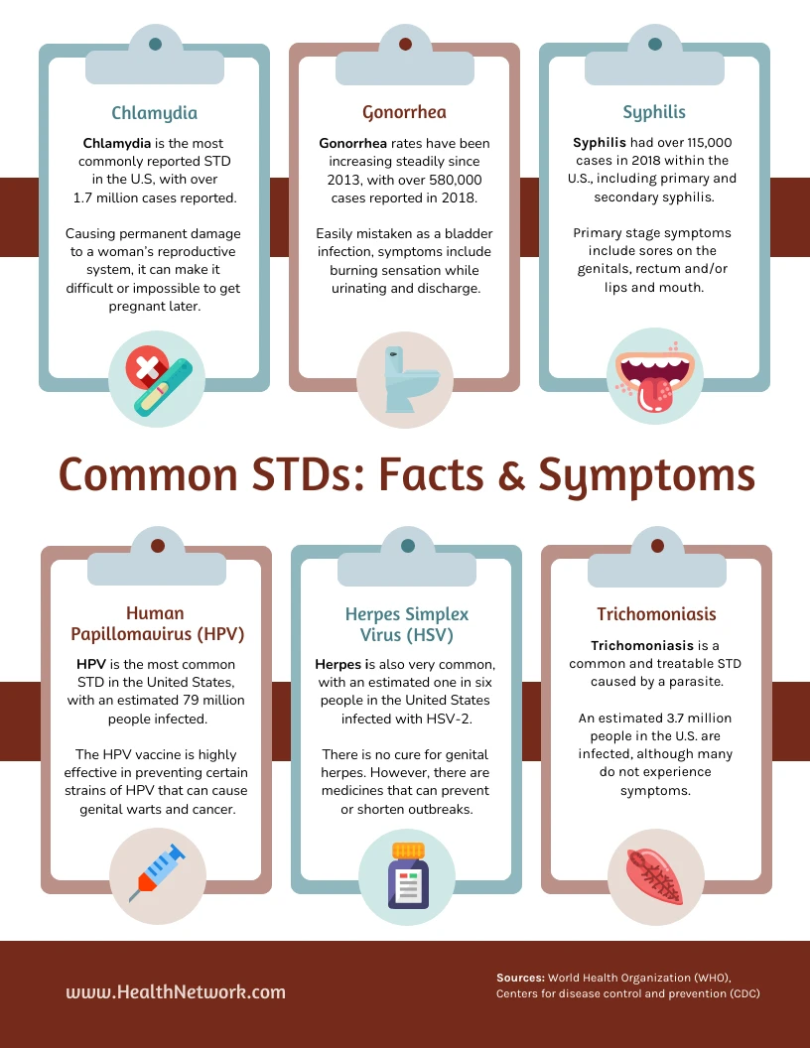
Most common STDs in the United States
Coin flip website
Percentages of each illness

Slide 15
STDs continued
The important thing to know is that STDs are out there and more than 50% of people report having one in their life.
Using a condom can prevent almost all STDs!
If you are sexually active, get checked regularly (especially if you have symptoms!)
Your partner deserves to know, and vice versa!

Slide 16
Sexual health Stats
The “pull out method”
Out of 100 people, how many who only use the “pull out method” end up pregnant in a year?
A) 2 B) 8 C) 15 D) 22
D) 22!
How many people report having an STD at some point in their life?
A) 0.5% B) Less than 12% C) More than 50% D) 96%
C) More than 50%!

Slide 17
Sexual health checkup
What happens?
  They will check your genitals visually and sometimes by touch to make sure you are healthy
  They may make you pee in a cup (alone) to have your urine tested in a lab
  They may give you an HPV vaccine
  They will ask you some questions about your sexual history, your lifestyle, and any pain or sensations you are feeling.
None of these things will be painful to you or awkward for the doctor—remember, they do this ten times a day! They’re professionals and this is their job.

Slide 18
Talking to a doctor
During the Appointment:
Be Clear and Honest: If you are having symptoms, describe them in detail ("I've had sharp chest pains for 3 days, especially after eating").
Ask Direct Questions: about anything that you are unsure about.
Your doctor has heard it all!
Questions you can ask:
  What does that mean
  What are my options
  Will this effect X
Confirm Understanding: Make sure you are paying close attention to what the doctor is telling you!
Get to know your doctor: and remember who they are. You might need to know who your doctor is for multiple reasons.
After the Appointment:
Follow Instructions: If there is anything the doctor tells you to do, don’t forget!
Ask About Next Steps: Find out when and how to follow up. Sometimes, you will need a follow-up appointment. Schedule this as soon as possible!

Slide 19

Should I lie to my doctor?
Your doctor is there to take the information that you tell them, the information that they see, and their medical training and come up with the best course of action for you. If you don’t provide them with the truth (or even just part of the truth), you’re hurting your chances to be healthy!
The person you hurt by lying to the doctor is yourself!

Slide 20
What if I don’t feel heard by my doctor?
Doctors recommend that if you don’t feel as though you are being heard, to use these phrases:
“This is not normal for me”
“I know my body and something isn’t right”
“I think there is more going on than what we discussed”
If you need to reemphasize your feelings or symptoms, these phrases are especially effective with doctors that don’t seem to be listening.

Slide 21
Health insurance
What is insurance?
  A fund that many people pay into that pays out when you need medical help.
Medicaid:
  Government-funded health insurance.
  Covers essential services like doctor visits, hospital stays, and prescriptions.
  Free or low-cost, but fewer provider options.
  Foster youth automatically get Medicaid!
    Expires at age 26
Private Insurance:
  Purchased through employers or marketplaces.
  Offers more provider choices and specialized care.
  Higher costs (monthly premiums, co-pays, deductibles).

Slide 22
Private Insurance: Copay
What is a copay?
A fixed amount paid for medical services, like doctor visits or prescriptions
Example: $25 per doctor’s appointment
Why do copays exist?
It is a way for your insurance agency to split the cost of frequent medical appointments with you
It is a way to disincentivize you from going to the doctor unless you think you need to
Where can I find my copay information?
On your insurance card
On your insurance agency’s website
By calling and asking!

Slide 23
Private Insurance: “in-network?”
Insurance agencies have deals with certain hospitals, healthcare providers, and other facilities.
1
Places that are not “in-network” are much more expensive! Anywhere from 200%-400% more!
2
When you have a choice in healthcare, make sure it is “in-network!”
3

Slide 24

How do I find what’s in-network?
Visit
Visit Your Insurance Website:
Log in to your insurance account.
Use the "Find a Provider" tool to search for doctors, hospitals, or services.
Call
Call Your Insurance Company:
Use the customer service number on your insurance card.
Ask if the provider is in-network.
Ask
Ask the Provider Directly:
Contact the doctor’s office or hospital.
Confirm they accept your insurance and are in-network.
Check
Check Your Insurance Card:
Some cards list preferred networks or providers.

Slide 25
Urgent care vs ER
Urgent Care:
Handles non-life-threatening issues.
Examples: Minor injuries (sprains, strains), mild illnesses (cold, flu), minor infections (pink eye, UTIs).
Lower cost and shorter wait times.
Open extended hours, including weekends.
Emergency Room (ER):
Treats life-threatening emergencies.
Examples: Chest pain, stroke symptoms, severe head injuries, uncontrolled bleeding.
Higher cost and longer wait times.
Open 24/7 for critical care.

Slide 26
Thanks for coming!
Any questions?

