Slide 1
Get and Maintain a Bank Account
Teacher: Sam

Slide 2


Why bank account?
It is a part of becoming an adult to be able to control your own money!
If you want to be able to see, manage, and grow your money, you will need a bank account!
Jobs will want to deposit your money into an account automatically.

Slide 3

How Youth bank accounts work
Most banks allow minors (under 18) to sign up for a youth bank account.
Youth bank accounts are a way to let minors control their money and learn how to manage it.
Youth bank accounts have a lot of restrictions that adult bank accounts do not have.
  Minors cannot use credit cards
  Accounts have lower spending limits
  Youth accounts may waive fees like monthly maintenance fees

Slide 4

Foster Youth Bank accounts
Foster youth have Kansas Statute 9-1204 that states:
  Any bank that accepts deposits from minors 16 years of age or older in the custody of the secretary for children and families … shall not require a cosigner or the funds to be deposited with the consent of the custodian. Such minor shall be responsible for banking costs or penalties associated with such deposits. The secretary, or their designee, or any foster or biological parent shall not be responsible for banking costs or penalties associated with such deposits.

Slide 5
Foster Youth Bank Accounts
What does that mean?
  Usually, banks require youth to have a cosigner (usually biological parent). That cosigner is responsible for fees or penalties that the youth gets.
  Because this could prevent some foster youth from getting a cosigner, Kansas has decided that foster youth do not need to have a cosigner.
  But what happens to the fees and penalties that the cosigner would pay?
  In foster youth cases, the youth pays the fees and penalties for account issues.

Slide 6
Overdraft Fees
Debit account is overdrawn (more money is pulled from the account than the account has in it)
Bank covers the funds by letting the payment go through. The account goes into the negative and a fee is added on (usually about 35$).
Account owner pays back the bank by adding money to the account again. They still have to pay the fee!

Slide 7
How do I prevent overdrafting?
You can opt out of overdrafting at some banks.
  This would leave you unable to pay for things like gas in an emergency (no funds in your account and no cash on you)
  This can be prevented by keeping an eye on your money, checking your accounts regularly, and making sure you have a buffer of at least $300 in your accounts.
Some banks provide “Overdraft Protection” which can pull funds from a different account to prevent fees.
Set up account alerts to let you know when your account is below a certain amount.

Slide 8
Checking vs Savings
Checking accounts
Easily accessible with a debit card or check
Low return on money
Fewer fees (sometimes none)
No limits on withdrawals
Savings accounts
Built for saving and growing money
Higher rates of return for your money
Maintenance fees
Limits on withdrawals per month

Slide 9
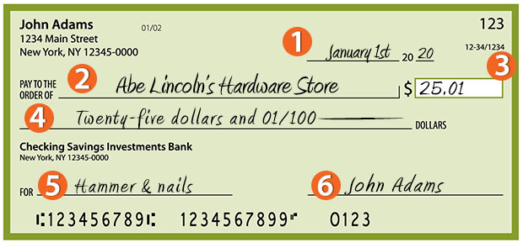
How to sign a check
Date
Who you’re giving money to
Amount
Amount printed out
What it is for
Your signature

Slide 10
Rule of 72 (what the heck is interest rate?)
Interest rate is how much money a bank (or other financial institution) will give you if they can hold your money. If the interest rate is 3%, they will give you an extra 3% of your money back for free.
What does that mean in reality?
72/Interest Rate =
How many years to double your money
72/3% = 24 years

Slide 11
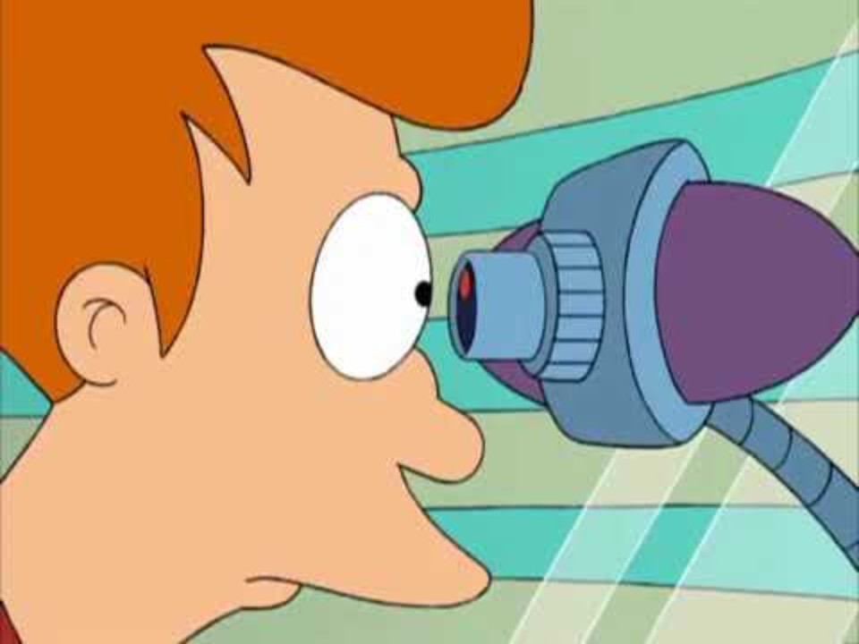
Fry’s bank account
Balance in 2000: $0.93
2.25% interest over 1000 years
Balance in 3000:
$4,283,508,449.72

Slide 12

Who has earned your money?
When a check comes in for the work you do, who should you be giving the money to first?
  You have a lot of options. There will always be something to buy and an experience to pay for.
    all-pink clothes
    food delivery
    V-bucks
    a used Gameboy Color from 1999
    rollerblades
    broken keyboards
    kneeboards
    a flight to Hawaii
    a Photoshop account to fake like you flew to Hawaii
    or any other number of things.
But who has earned your money?

Slide 13
YOU. YOU EARNED THAT MONEY
PAY YOURSELF FIRST!

Slide 14
Once you pay yourself, who’s next?
Anyone you owe money to:
  Rent – you owe them money every month to live there!
  Utilities – You owe them money to use your power, gas, and internet.
  Bills – you owe money to use a phone or insure your car.
  Jimmy from school who sold you his 1999 Gameboy Color.
  Adobe Photoshop subscription so you could fake going to Hawaii.
  The Twitch sub for Shroud you bought when PUBG was cool.
  World of Warcraft subscription you forgot to cancel for a YEAR.
  Spotify subscription so you can listen to lofi citypop chillbeat trap remix vibes (slow version) feat. Doja Bunny & Bad Cat

Slide 15
Klarna, Afterpay, buy now pay later
BNPL apps and services are all over the place now. More than 500,000 businesses use them.
How do they work?
  They allow users to pay for anything over a few months instead of right now.
  They make their money because they know you will forget to pay it or not budget for it.
  BNPL makes its money by betting that you can’t come up with the money every month to pay for something you bought months ago.
  Gen Z is the biggest BNPL target with 41% of Gen Z users end up missing a payment and getting fined.
  Gen Z also has the highest amount of debt per person to BNPL with $254 of debt per month.
  It’s like adding another bill!
  Unless you have to, never buy something with money you don’t have! Only spend money you have and you will be doing better than 41% of Gen Z!

Slide 16

Online Banking
Banks have websites and apps that can be used to access your account information.
Most banking is done online. The principals are the same as traditional banking.
With a bank app or online webapp, you can
  Look at your account balance
  Find your account information
  Contact your bank
  Find entries in your account history
  Make payments online
  Transfer money between accounts
  And more!

Slide 17
Online Bank Account

Slide 18

Any Questions?

Slide 19
Thank you for coming!
Please fill out a review with your name
See you next class: How to Talk to Adults (professional relationships)!

