Slide 1
How to crush a job interview
Please sign in! Teacher: Sam

Slide 2
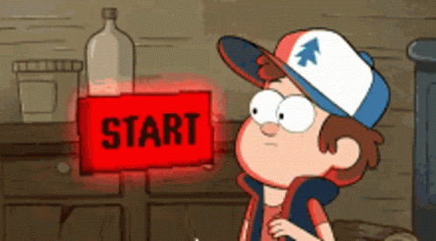
Why do employers interview?
Employers want to see if you can play the game
Wait…what game?

Slide 3
Job interviewing is a game that both sides are playing
There is a goal
There are plays and strategies both sides can use
There are rules that define what you can and cannot do!
We’re going to learn the rules together.

Slide 4
What games do you play?
What is the goal?
What are the plays/strategies?
What are the rules?

Slide 5

Walking out of an interview before this class:

Slide 6
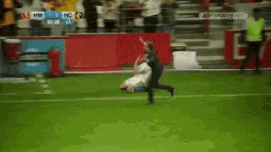
Walking out of an interview AFTER this class:

Slide 7
Who has done a job interview?
How did it go?
What questions did they have?
What did you wear?
How did you feel going in and walking out?

Slide 8
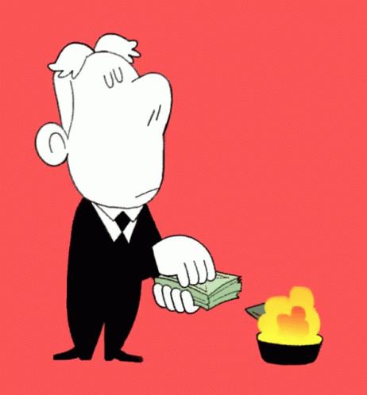
What the game is for
The company wants to learn about you and see if you’re a “good fit”
They might be spending a lot of money on you!
How much money do you think it costs to hire someone?
The median cost-per-hire in 2021 was $1,244.
That’s just to get the person hired!
They don’t want to waste any time or money.

Slide 9




The Rules of the game
Clothes:
Sharply dressed, clean, appropriate
Language:
Polite, clean, respectful
Attitude:
Eager to be there, paying attention
Presentation:
Good hygiene, show up early, ask questions

Slide 10
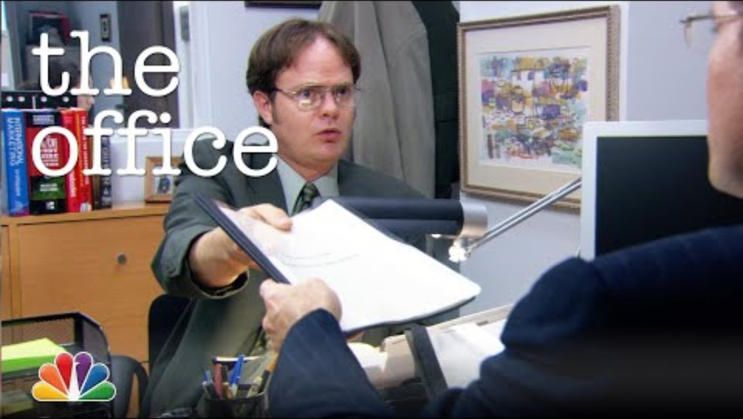

Slide 11
How did Dwight do?
Clothes:
Sharply dressed, clean, appropriate
Language:
Polite, clean, inappropriate
Attitude:
Eager to be there, overconfident
Presentation:
Showed up on time, overprepared

Slide 12

Your turn to interview me!

Slide 13

How did each candidate do?
What stuck out about each one?
What are some good signs? Bad signs?
Which one would you hire?

Slide 14



What happens after the interview?
Follow up!
Email or call to show interest and eagerness
Thank them for the opportunity!
During and after the interview—even if you don’t get the job!
Stay available!
Monitor your phone and email for contact
Be responsive!
Be quick to respond when you are contacted

Slide 15
Final Thoughts
Cornerstones of Care can help with basic interview clothes!
  Talk with your IL worker/caseworker if you need some.
Always be thinking:
  “What kind of person would I want to hire for my business?”
Remember to play by the rules!

Slide 16

Questions?

Slide 17
Thank you all for coming!
Please fill out the review form!

